Slide 1

ESI 4620 Principles of Data Engineering (ESI 6602 Design of Industrial Data Systems)
Department of Industrial and Management Systems Engineering College of Engineering, University of South Florida
Spring 2023

Slide 2
ESI 4620 Principles of Data Engineering (ESI 6602 Design of Industrial Data Systems)
Project Guidelines

Slide 3

Groups
2
Students (undergraduate and graduate) are divided in groups of four persons.

Slide 4
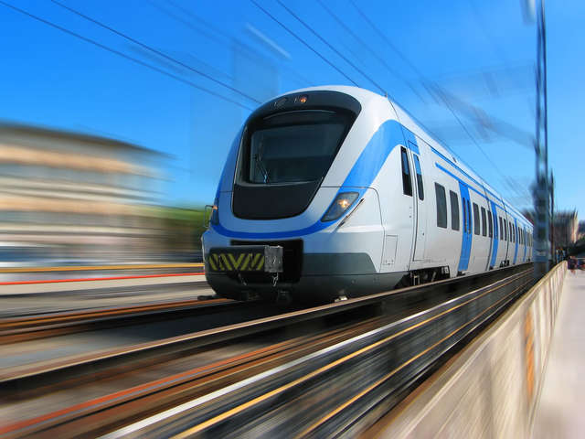
Project
2
Tampa Railway Company

Slide 5
Project
Tampa City wants to develop a Railway Management System for a future train connecting Tampa and Orlando city. This service should consider at least, but not be limited to, the next relations: (It doesn’t mean that these are the only tables to present)
Customers: Refers to registered passengers that use the service.
Employees: All people working in the company.
Routes: Refers to available trips (requires origin, destination, day of the week and scheduled time).
Travels: Are generated from a scheduled route.
Locations: Refer to the physical areas (where passengers depart, arrive or buy tickets) or machines where passengers can buy tickets.
Tickets: Customers buy them for specific travels. A non-registered customer can also buy them.
Trains: Are assigned to specific travels.
Cabins: Refers to the class (1st or 2nd class). Price depends on the combination of route and cabin.
Payments: A ticket can generate one or more than one payment.
Discounts: Applied to tickets and include a percentage of discount over the original price.
3

Slide 6
Project
3
Think that you will manage the system. Hence, consider all relevant attributes to include within your relations to capture all desired information to be used later in a making decision process. Be exhaustive with the attributes to consider.

Slide 7
Meetings
10
Group’s members have to meet on a regular basis and they should submit a participation report along with each Report submitted. Grades will be proportional to participation.

Slide 8
Deadlines and deliverables
10
Deliverables for this project | Due date
Report I | March 10th: 9:00am
Report II | April 7th: 9:00am
Report III | April 21st: 9:00am
Late submissions are penalized 10% per hour late.
Project 2 represents 25% of your final grade.

Slide 9
Grades
10
Report 2.1 is worth 5%
Report 2.2 is worth 12%
Report 2.3 is worth 8%

Slide 10
Report I - deliverable
For this Part-I report, groups need to submit:
ERD
Verify normalizations
Relations, including attributes, constraints (primary key, foreign key, and check constraints)
About submission:
Due date is Friday, March, 10th at 9am (files version on CANVAS). Late projects will receive penalty
Be as much accurate as possible with the information you search and the one provided.
Submit a .sql file. The file should be clean and run perfectly in one execution. ERD will be obtained from that file.

